Slide 2
Chapter Conflict of Interest

Slide 3
What we’re going to discuss
What is Conflict of Interest?
Types of Conflict of Interest
What’s the Harm?
Questions to Ask
What it Means to You
What to Do?
Notes:
As Chapter Leaders it’s important to be aware of any potential conflict of interest, so we’ll go over:
What conflict of interest is
Types of Conflict of Interest
Harm caused by any Conflict of Interest (real or perceived)
Questions to ask yourself in determining if there is a conflict of interest
What it means to you
What to do as an individual and what we should do as a Board

Slide 4
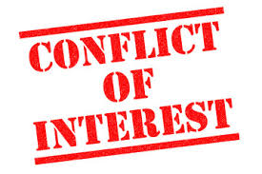
What is Conflict of Interest?
Conflicts of interest are a normal situation arising often in Chapters
Board Members are with training providers, consultancies, vendors and other interested parties in their day jobs.
Perceived conflicts of interest are just as taboo as actual ones
As a Board Member your 1st priority and duty is to your Chapter
Notes:
A conflict of interest is where a person has multiple interests and serving one interest could involve working against or potentially harm another.
It is also a situation in which a person can derive personal benefit from actions or decisions made in their official capacity.

Slide 5
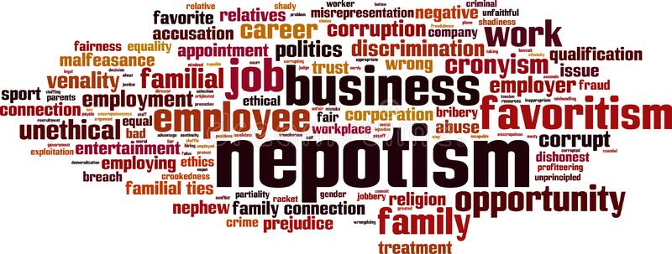
Types of Conflict of Interest
Self Dealing/Serving
Using involvement in the Chapter for their own gain
Not necessarily criminal
Maybe even benefits the Chapter
Nepotism
Contracting or hiring a
family member or close friend
Promotion of a 3rd Party

Slide 6

What’s the Harm?
It can damage the reputation of the Chapter and the Board
There can be financial and legal ramifications for the individual and the Board

Slide 7
Examples of Conflict of Interest
Providing training or workshops during a PDD
Close friends providing catering for Chapter events
Your recruiting company sponsoring a Chapter event
Personally accepting gifts or payment for access to Chapter members
Using Chapter resources (e.g. Member lists) for personal or professional gain

Slide 8
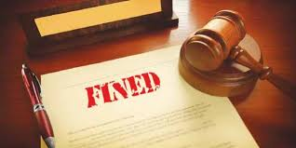
Case of Conflict of Interest
Former Head of Ohio State Retirement System Fined
Hired his brother to perform $150,000 of computer work.
Misdemeanor (down from felony) charge and fined.
Even though it was agreed that his brother “was providing better service at a low rate, so there was no harm done.”
Link to PDF of article content: https://drive.google.com/file/d/1EaLJmwxQ089nC2MS1A2JmNTYGs9OCIP2/view?usp=sharing
Notes:
The former head of Ohio State Highway Patrol’s Pension Fund hired his brother to perform $150,000 of computer work.
Article referenced
By Darrel Rowland, The Columbus Dispatch
Posted Sep 13, 2013
The former head of the Ohio State Highway Patrol’s retirement system was fined $250 this morning for hiring his brother to perform more than $150,000 of computer work for the pension fund.
The former head of the State Highway Patrol’s retirement system was fined $250 this morning for hiring his brother to perform more than $150,000 of computer work for the pension fund.
Dan Weiss, 52, of the North Side pleaded guilty to having an illegal conflict of interest, a first-degree misdemeanor.
The relatively low fine stemmed from the fact that Weiss’ brother, who was with JTech Computer Services, actually gave the retirement fund a good price and adequately performed the work for more than nine years.
However, Ohio law bars public officials from hiring a close relative. Weiss “did recklessly use or authorize the use of the authority or influence of his office or his employment to secure (something) of value that was of such a character as to manifest a substantial and improper influence upon him with respect to his public duties,” court documents say.
Franklin County Prosecutor Ron O’Brien said the plea was negotiated down from a felony charge of having an unlawful interest in a public contract. While Weiss informed at least some Highway Patrol pension officials about his brother, he also “sent emails and attended meetings saying what a good job his brother’s company was doing,” O’Brien said.
Weiss’ attorney, H. Ritchey Hollenbaugh, said all parties agreed to the low fine.
Weiss’ brother “was providing better service at a lower rate, so there was no harm done. But it was a relative and ... that’s not something you can do,” the defense lawyer said. Pension board members were aware of the relationship, Hollenbaugh said.
Judge James O’Grady of Franklin County Municipal Court levied the fine in the case, which was investigated by the Ohio Ethics Commission. Weiss also must pay court costs.
Weiss, who could face disciplinary action because he is also an attorney and a CPA, left the retirement system at the end of 2011. He had been executive director/chief investment officer for two years, and was chief financial officer for the previous nine years.
He went on to found Counterpart CFO, which offers shared CFO and legal services.
Paul Nick, executive director of the Ethics Commission, said Weiss’ departure was at least partially related to his office’s probe.
“We received a tip that the Highway Patrol Retirement System had been paying JTech Computer Services and that this company was owned by Weiss’ brother, Jon,” Nick said.

Slide 9
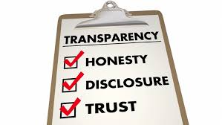
What it means to you
You are responsible to ensure that there is no sense of impropriety
You must act with full disclosure and transparency
You must not put yourself or the Chapter in the position where a conflict of interest is perceived

Slide 10

Questions to ask
Is there a way that I could benefit from this decision?
Could someone that I have a close relationship with benefit?
Am I in a position to influence in any way?
If I was an outsider looking at this situation would I think that there was something dodgy about it?

Slide 11
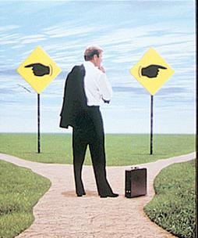
What to Do as an Individual
Be aware that a perceived conflict of interest is a conflict of interest issue
Disclose a potential conflict immediately!
Recuse yourself from any decision where you or others close to you might benefit
Document everything
When in doubt, ERR ON THE SIDE OF CAUTION!

Slide 12
What to Do as a Board
Discuss potential conflicts of interest and document everything in the minutes
The person with the potential conflict should abstain from any discussion of the matter unless they are representing ONLY the viewpoint of their portfolio
The person with the potential conflict should be removed or abstain from any voting
Act in accordance with the Chapter Affiliation Agreement where Board Members be held to the highest standards of ethical behavior; to act honestly, in good faith, in the best interests of IIBA; to act in accordance with all applicable laws, including common law and the Canada Not-For-Profit Corporations Act, and with the letters patent and bylaws of IIBA.

